Slide 1

Foundations of R?
Derek H. Ogle
Northland College

Slide 2
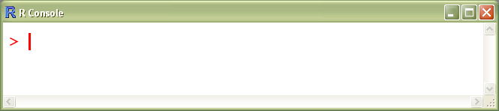
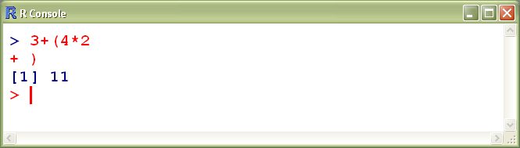
R Prompts
Generally hit the STOP button and start over

Slide 3
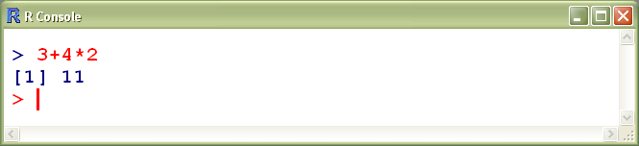
Calculations
Expressions
  Generally, mathematical “equations” that are evaluated to produce a result that is seen
  Order of operations is same as calculator

Slide 4
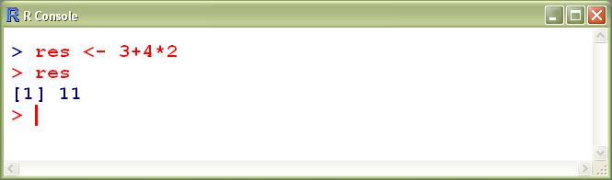
Calculations
Assignment
  Similar to an expression but the result is assigned to an object, result is not immediately seen
assignment operator

Slide 5
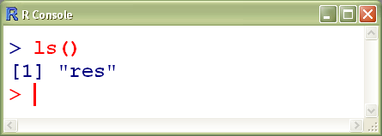
Objects
A named memory position that holds a result of interest
R
Type ls() to get list of existing objects
res
11

Slide 6
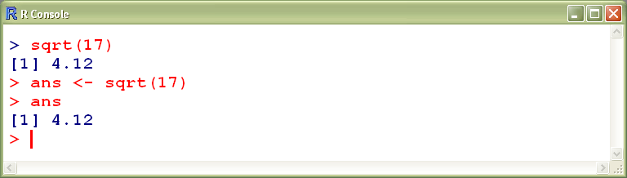
Functions
Built-in routines for specific tasks.
  “called” by name
  sent various arguments
    in parentheses (primary use of parentheses in R)
    separated by commas (primary use of commas in R)
  result can be assigned to object
  object <- function(arg1,arg2,arg3,…)

Slide 7
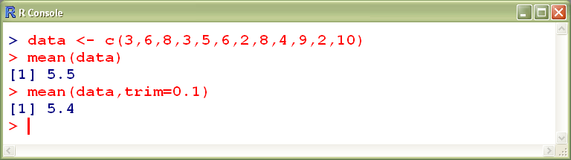
Functions
Two types of arguments.
  Unnamed or Positional
    Usually required arguments.
    Usually first few arguments.
  Named
    Must have argument name, equals sign, and “value”.
    Usually not required.
    Usually set to some default value.

Slide 8
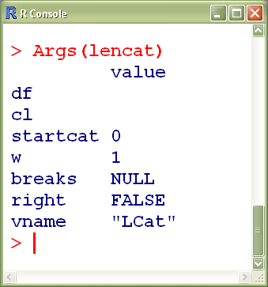
Functions
Help with arguments
  type ?functionname
    this will bring up a help system
  type Args(functionname)
    requires gdata package (loaded with FSA)

Slide 9
Functions
Two types of functions.
  Constructor
    These “do lots of something”.
    Result usually saved to an object.
  Extractor
    Extracts a certain “something” from the saved object.

Slide 10
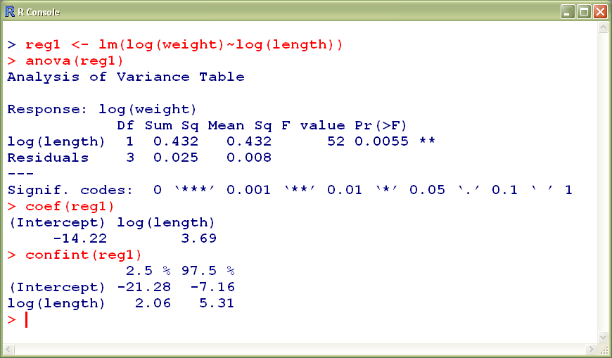
Constructor & Extractor Functions

Slide 11
Data Types
Integer
  8 2 10 4
Numeric – non-integer numbers
5.39 6.79 10.66
Character – letters, words
  Winni Leech Mille.Lacs
Logical – TRUE or FALSE
  TRUE TRUE FALSE TRUE

Slide 12
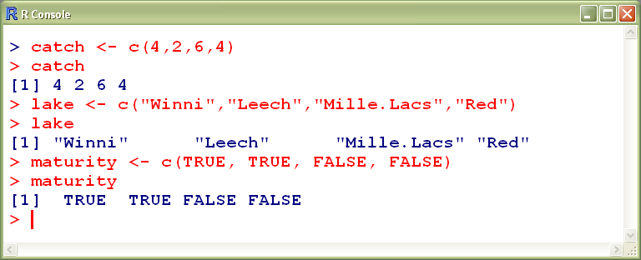
Data Storage
Vector – series of numeric, character, logical values
  Primary data structure in R
  Items entered with concatenate function (i.e., c() )
    arguments to c() are the individual items to concatenate

Slide 13
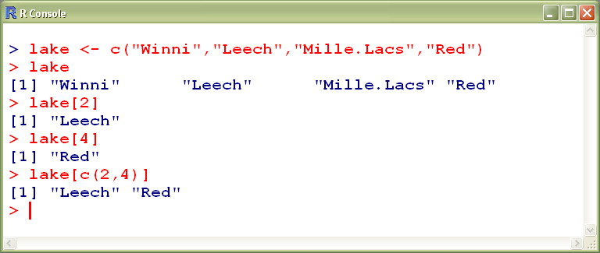
Data Storage
Vector
  one-dimensional
  Specific items are found by inputting position within square brackets (primary use of square brackets in R)

Slide 14
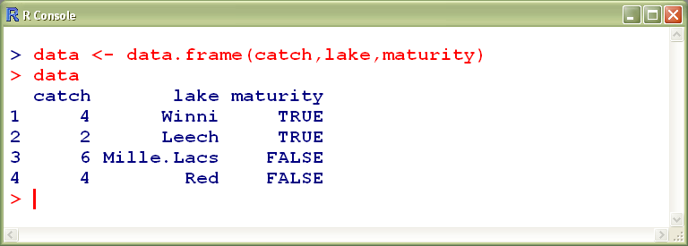
Data Storage
Data Frame – a “spreadsheet”
  Columns correspond to variables.
    can be of a different type.
  Rows correspond to individuals.

Slide 15
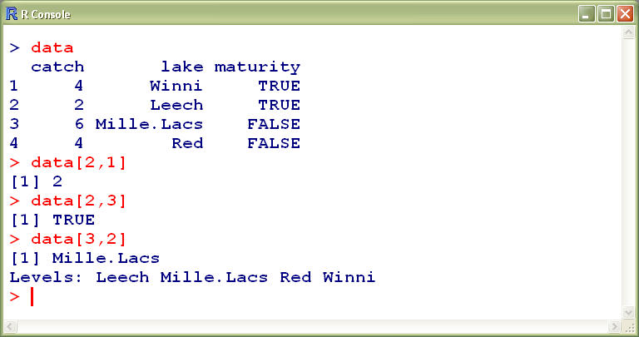
Data Storage
Data Frame – a “spreadsheet”
  multi-dimensional
  indexed by rows then columns

Slide 16
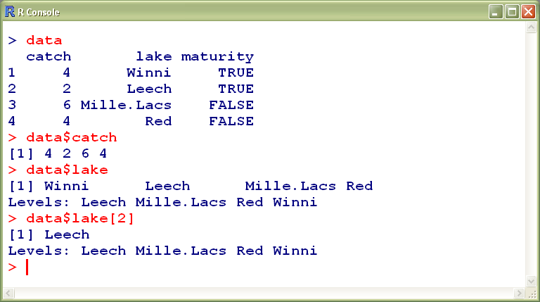
Data Storage
Data Frame
  Also indexed by column name
    i.e., dataframe$varname (only use of $ in R)

Slide 17
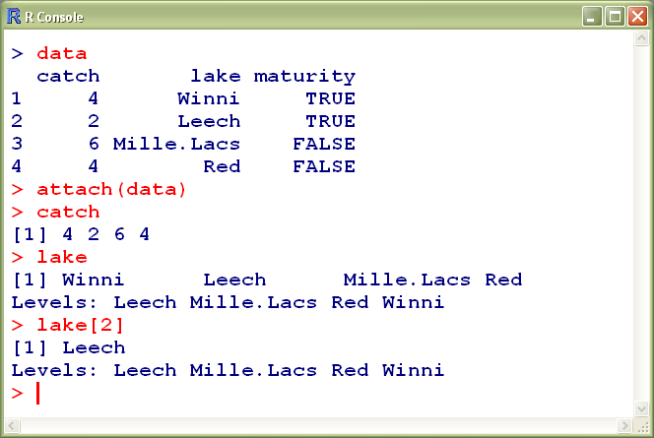
Attaching Data Frames
Tells R to always look in attached data frame first
  Thus, don’t have to type data frame name each time
    e.g., type varname rather than dataframe$varname

Slide 18
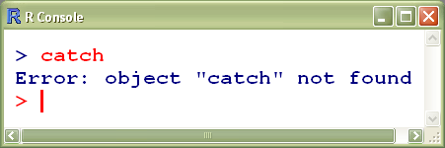
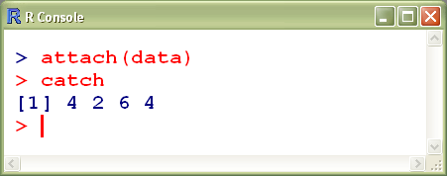
Attaching Data Frames
Unattached
Attached
R
R
data
data
catch | lake | maturity
4 | Winni | TRUE
2 | Leech | TRUE
6 | Mille.Lacs | FALSE
4 | Red | FALSE
catch | lake | maturity
4 | Winni | TRUE
2 | Leech | TRUE
6 | Mille.Lacs | FALSE
4 | Red | FALSE
res
res
11
11

Slide 19
Attaching Data Frames
NOTE, any command related to selecting entire rows of the data frame must still use the data frame name, even if the data frame is attached.
Don’t attach a data frame if simultaneously working with more than one data frame!
Detach data frame with detach(dataframe)
See what is attached with attached()
Detach all attached data frames with detach.all()

Slide 20
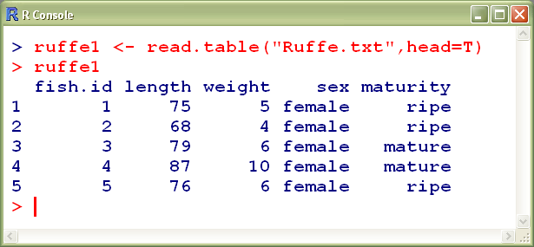
Constructing Data Frames
Tab-delimited text file with read.table()

Slide 21
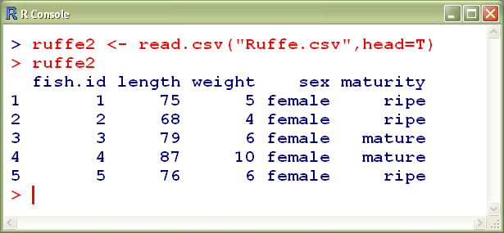
Constructing Data Frames
Comma-separated-values file with read.csv()

Slide 22
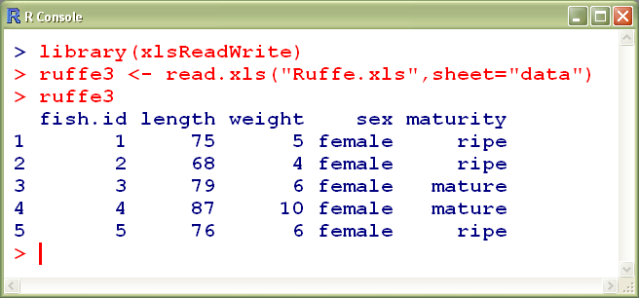
Constructing Data Frames
Excel file with read.xls()
  must load xlsReadWrite package
  can choose a worksheet with sheet= argument

Slide 23
Constructing Data Frames
Excel file with read.xls()
  must load xlsReadWrite package
  can choose a worksheet with sheet= argument

Slide 24
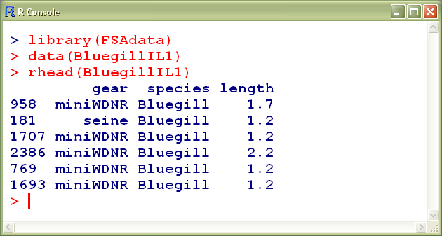
Constructing Data Frames
Data provided with package with data()
  must know data name

Slide 25
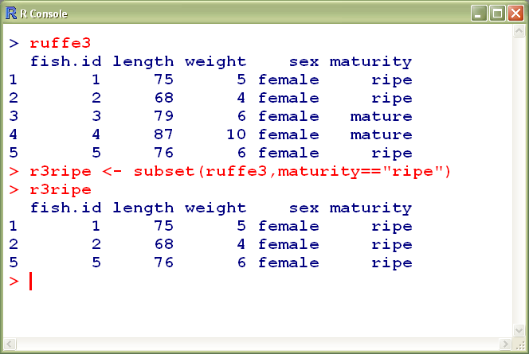
Subsetting a Data Frame
Use subset()
  first argument is whole data frame
  second argument is conditional statement

Slide 26
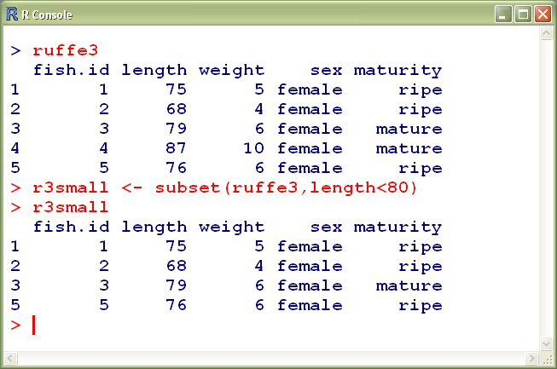
Subsetting a Data Frame

Slide 27
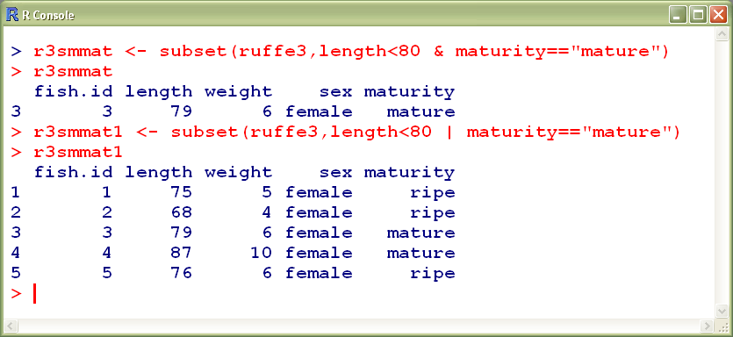
Subsetting a Data Frame

Slide 28
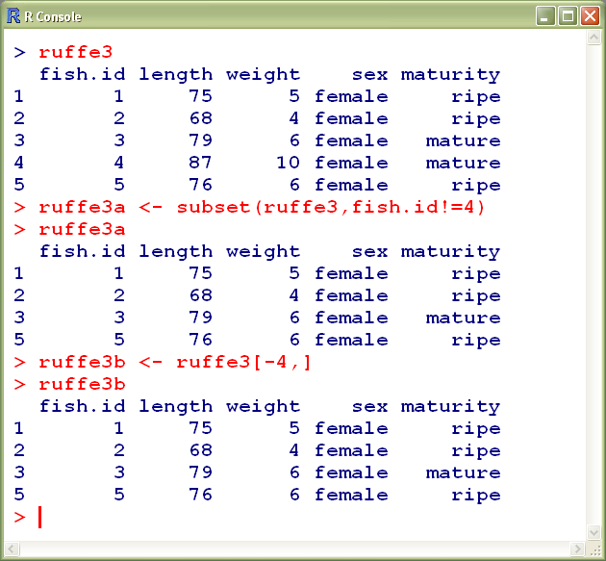
Subsetting a Data Frame

Slide 29
“Saving” Results
Recommendation:
  Do not save workspace images.
  Do save commands that work in separate text editor.
    WinEdt, Tinn-R, ESS, jEdit, or MSWord
    Like saving a script that allows repeating
  Do learn how to use Sweave.

